Slide 1
DASC 5301-002
Support Vector Machines
Dr Subharag Sarkar
Fall 2023
Slides Courtesy - Rózsa Záruba

Slide 2
Introduction
SVM is a powerful supervised algorithm that works best on smaller datasets but on complex ones.
Support Vector Machine, abbreviated as SVM can be used for both regression and classification tasks, but generally, they work best in classification problems.

Slide 3
Introduction
It is a supervised machine learning problem where we try to find a hyperplane that best separates the two classes.
Both the algorithms try to find the best hyperplane, but the main difference is logistic regression is a probabilistic approach whereas support vector machine is based on statistical approaches.
Notes:
After 1st point Note: Don’t get confused between SVM and logistic regression.

Slide 4
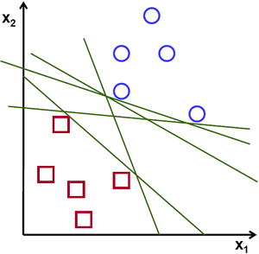
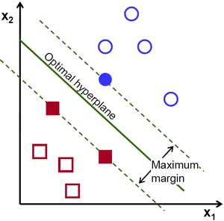
Introduction
The objective of the support vector machine algorithm is to find a hyperplane in an N-dimensional space(N — the number of features) that distinctly classifies the data points.

Slide 5
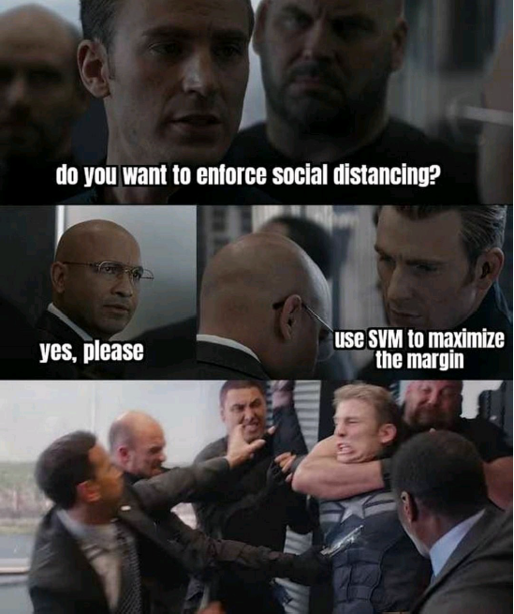
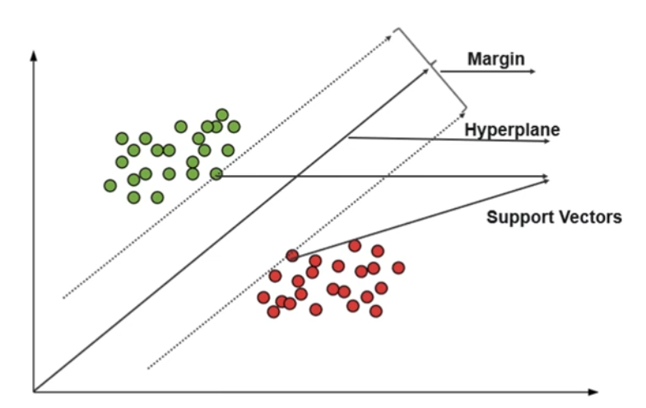
Introduction

Slide 6
Logistic Regression vs Support Vector Machine

Slide 7
Logistic Regression vs Support Vector Machine
Depending on the number of features we can either choose Logistic Regression or SVM.
SVM works best when the dataset is small and complex.

Slide 8
Logistic Regression vs Support Vector Machine
It is usually advisable to first use logistic regression and see how does it performs, if it fails to give a good accuracy you can go for SVM without any kernel (will talk more about kernels in the later section).
Logistic regression and SVM without any kernel have similar performance but depending on your features, one may be more efficient than the other.

Slide 9
Types of Support Vector Machines

Slide 10
Types of Support Vector Machine
Linear SVM:
When the data is perfectly linearly separable only then we can use Linear SVM.
Perfectly linearly separable means that the data points can be classified into 2 classes by using a single straight line(if 2D).

Slide 11
Types of Support Vector Machine
Non-Linear SVM:
When the data is not linearly separable then we can use Non-Linear SVM.
This means when the data points cannot be separated into 2 classes by using a straight line (if 2D) then we use some advanced techniques like kernel tricks to classify them.
In most real-world applications we do not find linearly separable datapoints hence we use kernel trick to solve them.

Slide 12
Hyperplane

Slide 13
Hyperplane
To classify data points, we can have many decision boundaries, but the question is which is the best and how do we find it?
We call this decision boundary a “hyperplane”
The best hyperplane is that plane that has the maximum distance from both the classes, and this is the main aim of SVM.
This is done by finding different hyperplanes which classify the labels in the best way then it will choose the one which is farthest from the data points or the one which has a maximum margin.

Slide 14
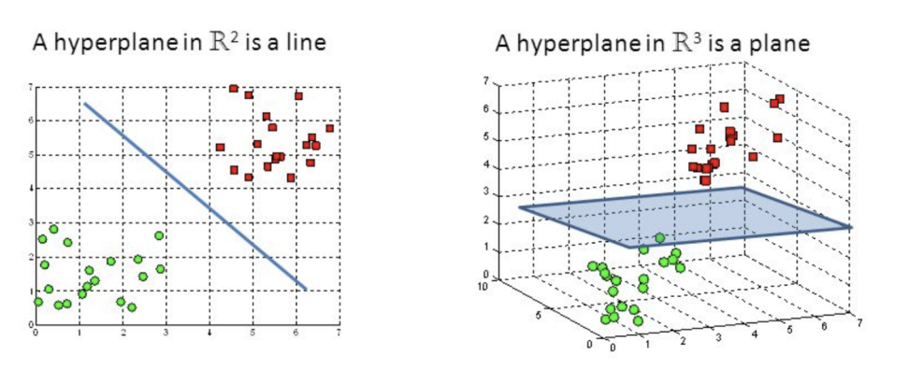
Hyperplanes
Hyperplanes are decision boundaries that help classify the data points.
Data points falling on either side of the hyperplane can be attributed to different classes.
Also, the dimension of the hyperplane depends upon the number of features.

Slide 15
Hyperplanes
If the number of input features is 2, then the hyperplane is just a line.
If the number of input features is 3, then the hyperplane becomes a two-dimensional plane.
It becomes difficult to imagine when the number of features exceeds 3.

Slide 16
Support Vectors

Slide 17
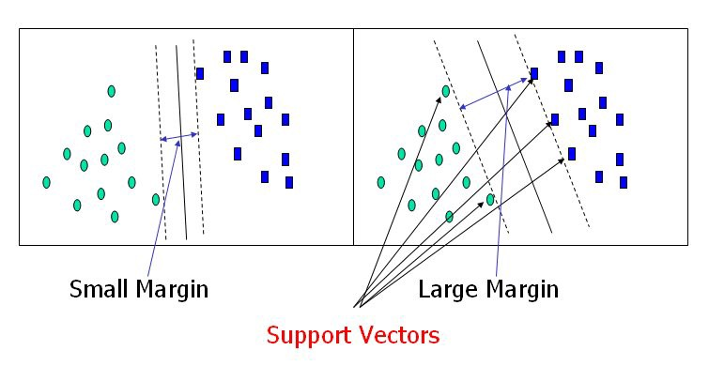
Support Vectors
Support vectors are data points that are closer to the hyperplane and influence the position and orientation of the hyperplane.
Using these support vectors, we maximize the margin of the classifier.
Deleting the support vectors will change the position of the hyperplane.
These are the points that help us build our SVM.

Slide 18
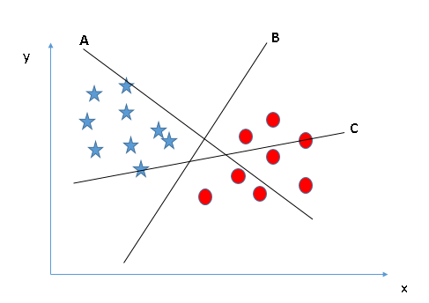
How can we identify the right hyper-plane?
Identify the right hyper-plane (Scenario-1):
Here, we have three hyper-planes (A, B, and C).
Now, identify the right hyper-plane to classify stars and circles.
Notes:
remember a thumb rule to identify the right hyper-plane: “Select the hyper-plane which segregates the two classes better”. In this scenario, hyper-plane “B” has excellently performed this job.

Slide 19
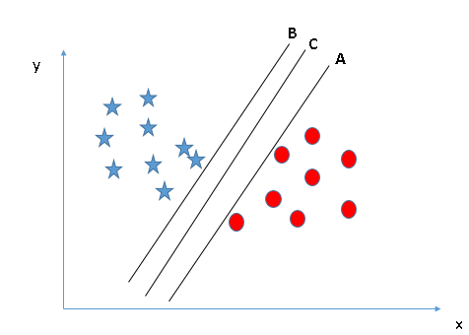
How can we identify the right hyper-plane?
Identify the right hyper-plane (Scenario-2):
Here, we have three hyper-planes (A, B, and C) and all are segregating the classes well.
Now, How can we identify the right hyper-plane?
Here, maximizing the distances between nearest data point (either class) and hyper-plane will help us to decide the right hyper-plane.
This distance is called as Margin.
Notes:
Above, you can see that the margin for hyper-plane C is high as compared to both A and B. Hence, we name the right hyper-plane as C. Another lightning reason for selecting the hyper-plane with higher margin is robustness. If we select a hyper-plane having low margin then there is high chance of miss-classification.

Slide 20
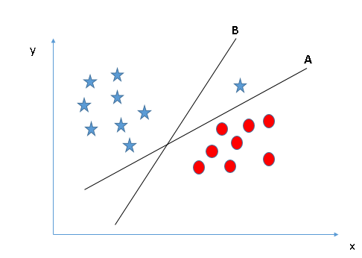
How can we identify the right hyper-plane?
Identify the right hyper-plane (Scenario-3):
Hint: Use the rules as discussed in previous section to identify the right hyper-plane.
SVM selects the hyper-plane which classifies the classes accurately prior to maximizing margin.
Here, hyper-plane B has a classification error and A has classified all correctly.
Therefore, the right hyper-plane is A
Notes:
you may have selected the hyper-plane B as it has higher margin compared to A. But, here is the catch, SVM selects the hyper-plane which classifies the classes accurately prior to maximizing margin. Here, hyper-plane B has a classification error and A has classified all correctly. Therefore, the right hyper-plane is A.

Slide 21
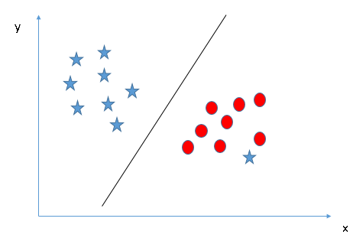
How can we identify the right hyper-plane?
Can we classify two classes (Scenario-4):
We are unable to segregate the two classes using a straight line, as one of the stars lies in the territory of other(circle) class as an outlier.
Notes:
one star at other end is like an outlier for star class. The SVM algorithm has a feature to ignore outliers and find the hyper-plane that has the maximum margin. Hence, we can say, SVM classification is robust to outliers.

Slide 22
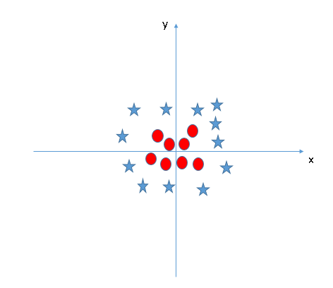
Find the hyper-plane to segregate to classes
(Scenario-5):
We can’t have linear hyper-plane between the two classes, so how does SVM classify these two classes?

Slide 23
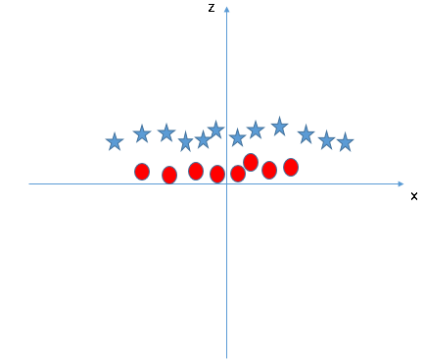
Find the hyper-plane to segregate to classes
(Scenario-5):
It solves this problem by introducing additional feature. It adds a new feature z=x^2+y^2.

Slide 24
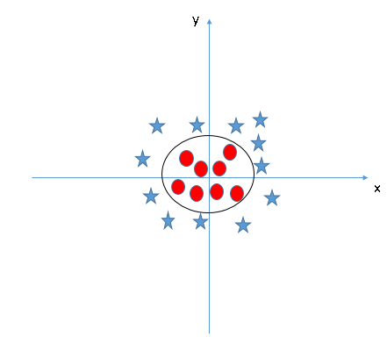
Find the hyper-plane to segregate to classes
This SVM algorithm is a technique called the kernel trick.
The SVM kernel is a function that takes low dimensional input space and transforms it to a higher dimensional space i.e. it converts not separable problem to separable problem.
It is mostly useful in non-linear separation problem.

Slide 25
Hard Margin vs Soft Margin

Slide 26
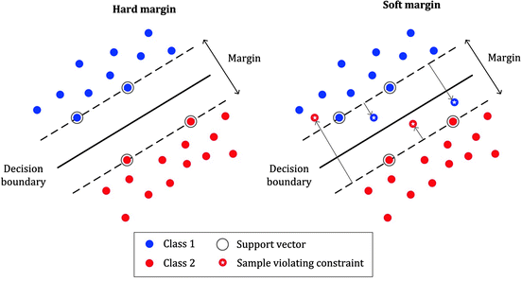
Hard Margin vs Soft Margin
Hard Margin: If the training data is linearly separable, we can select two parallel hyperplanes that separate the two classes of data, so that the distance between them is as large as possible.
Soft Margin: As most of the real-world data are not fully linearly separable, we will allow some margin violation to occur which is called soft margin classification.

Slide 27
Hard Margin vs Soft Margin
It is better to have a large margin, even though some constraints are violated.
Margin violation means choosing a hyperplane, which can allow some data points to stay on either the incorrect side of the hyperplane and between the margin and correct side of the hyperplane.
Notes:
After2nd point->We introduced two reasons why SVM needs to find the maximum margin. First, a large margin can avoid the effect of random noise and reduce overfitting. Second, a larger margin will lead to a smaller VC dimension, reduce the number of potential classifiers, and, therefore, reduce the possibility of generalization error

Slide 28
Parameters for SVM

Slide 29
Parameters for SVM
Regularization parameter (C)
Gamma parameter
Kernel
Degree
Random state

Slide 30
Regularization parameter (C):
The C parameter in SVM is mainly used for the Penalty parameter of the error term.
You can consider it as the degree of correct classification that the algorithm has to meet or the degree of optimization the SVM has to meet.
Controls the tradeoff between the classification of training points accurately and a smooth decision boundary or in a simple word, it suggests the model choose data points as a support vector.

Slide 31
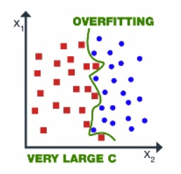
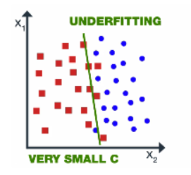
Regularization parameter (C):
For large C – the model chooses more data points as a support vector and we get the higher variance and lower bias, which may lead to the problem of overfitting.
For small C – the model chooses fewer data points as a support vector and gets lower variance/high bias.

Slide 32
Gamma Parameter
Gamma is used when we use the Gaussian RBF kernel.
If you use linear or polynomial kernel then you do not need gamma. You need C hypermeter.
It decides that how much curvature we want in a decision boundary.
High Gamma value – More curvature
Low Gamma value – Less curvature

Slide 33
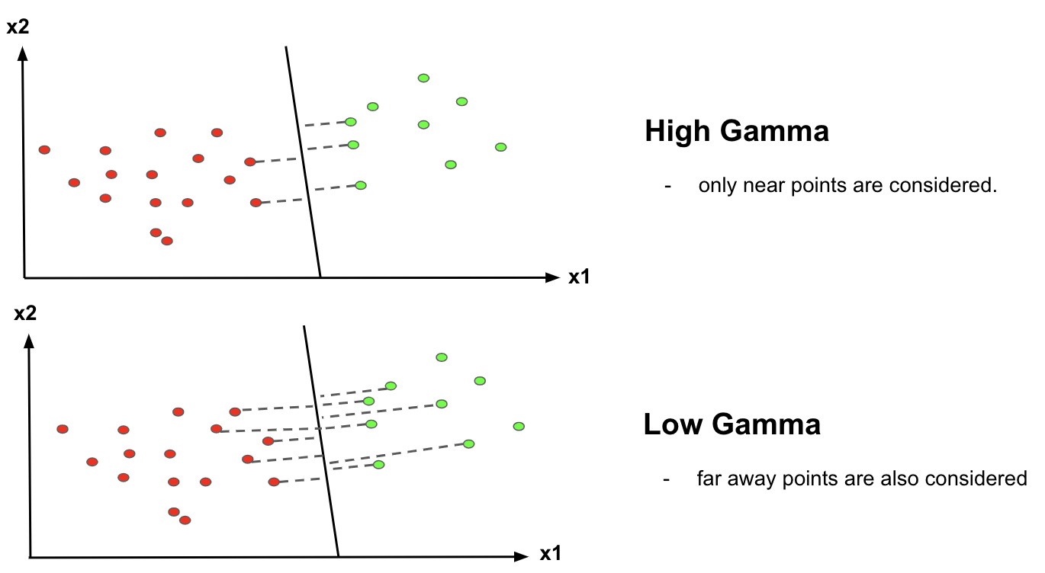
Gamma Parameter

Slide 34
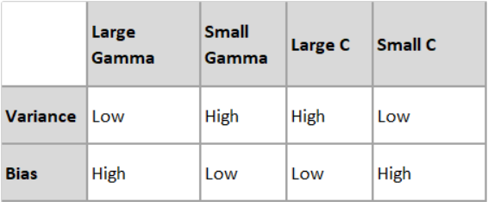
Gamma Parameter

Slide 35
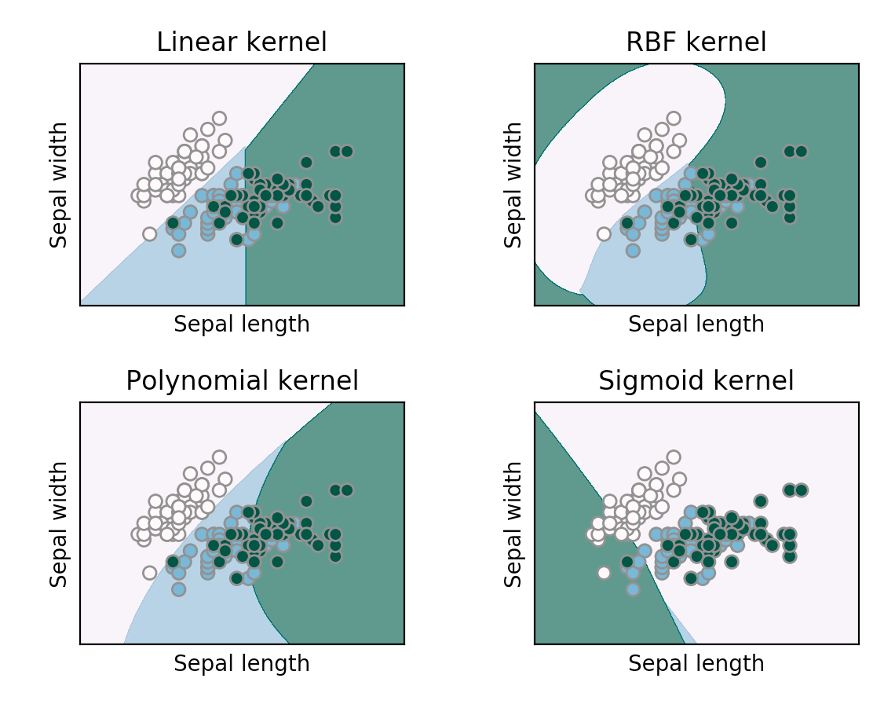
Kernel
This parameter, is very simple
For this parameter few options are available.
If you want to model it in a linear manner, we go for ‘linear’ option.
If your model did not have proper accuracy then you go for non-linear SVM like ‘rbf’, ‘poly’ and ‘sigmoid’ for better accuracy.

Slide 36
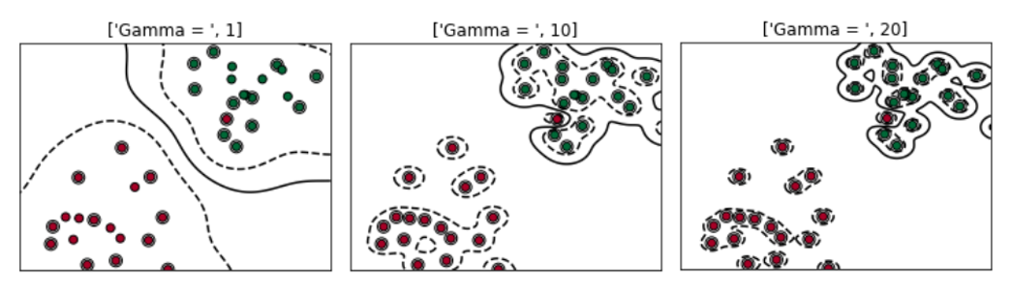
Degree
It controls the flexibility of the decision boundary.
Higher degrees yield more flexible decision boundaries.
Highly recommended for polynomial kernel

Slide 37
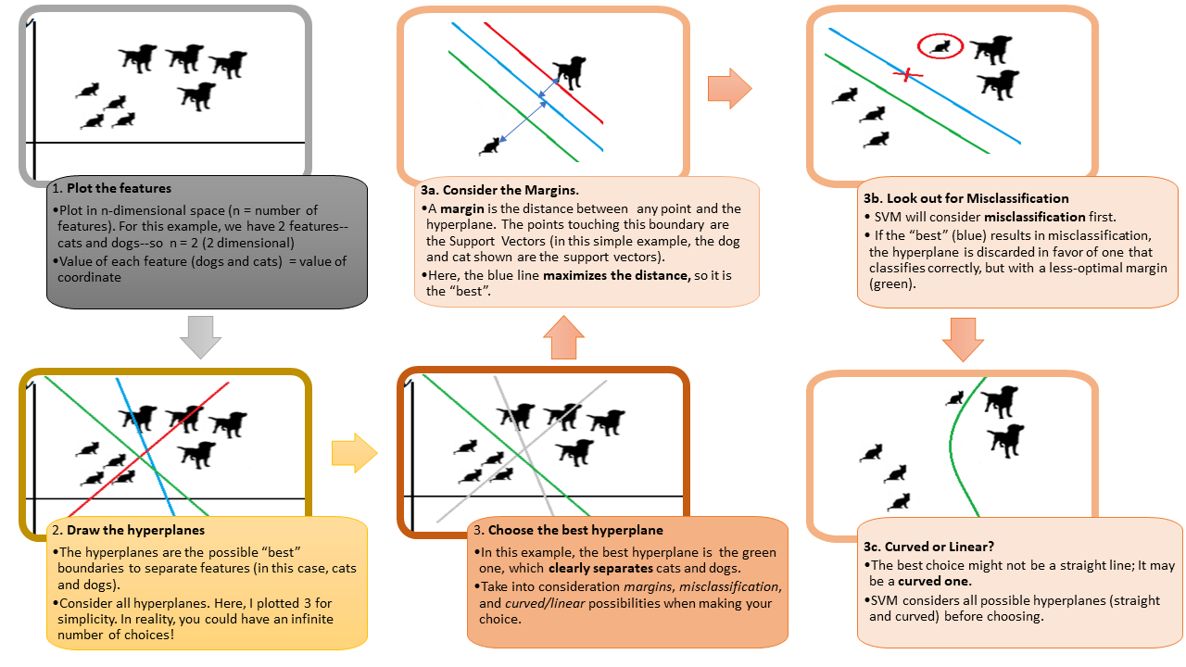

Slide 38
Applications
Handwriting recognition
Face Detection
Text and hypertext categorization
Image Classification
Bioinformatics (protein classification and cancer classification)

Slide 39
Pros vs Cons
Pros:
More effective for high dimensional space
Works well with even unstructured and semi-structured data like text, Images, and trees
Handles non-linear data efficiently by using the kernel trick
SVM has an L2 Regularization feature. So, it has good generalization capabilities which prevent it from over-fitting
A small change to the data does not greatly affect the hyperplane and hence the SVM. So, the SVM model is stable
Cons:
Not suitable for large dataset
Sensitive to outliers (If you have more in the dataset then SVM is not the right choice!)
Hyperparameters like cost (C) and gamma of SVM, is not that easy to fine-tune and also hard to visualize their impact
SVM takes a long training time on large datasets
SVM model is difficult to understand and interpret by human beings, unlike Decision Trees.
One must do feature scaling of variables before applying SVM

Slide 40
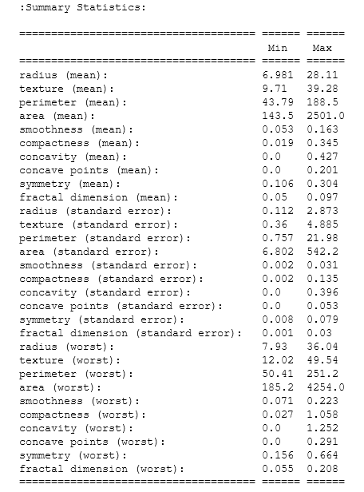
Example
Breast cancer wisconsin (diagnostic) dataset
**Data Set Characteristics:** :
Number of Instances: 569 :
Number of Attributes: 30 numeric, predictive attributes and the class
Attribute Information:
- radius (mean of distances from center to points on the perimeter)
- texture (standard deviation of gray-scale values) – perimeter
- area
- smoothness (local variation in radius lengths)
- compactness (perimeter^2 / area - 1.0)
- concavity (severity of concave portions of the contour)
- concave points (number of concave portions of the contour)
- symmetry
fractal dimension ("coastline approximation“ )
Class:
WDBC-Malignant
WDBC-Benign
Class Distribution: 212 - Malignant, 357 - Benign

Slide 41
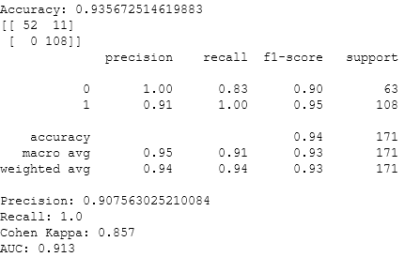
Results
Support Vector Machine
0- Malignant
1- Benign

Slide 42
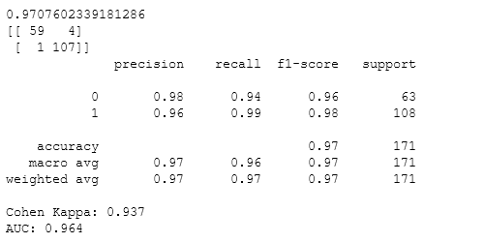
Logistic Regression
Support Vector Machine

Slide 43
References
https://www.analyticsvidhya.com/blog/2021/10/support-vector-machinessvm-a-complete-guide-for-beginners/
https://medium.com/datascienceray/svm-why-maximize-margin-b3d69528daf1#:~:text=We%20introduced%20two%20reasons%20why,the%20possibility%20of%20generalization%20error.

